Slide 1
RED BLACK TREE

Slide 2
What is a Red-Black tree
Red black tree is a form of binary search tree which satisfies following conditions:
Every node is either red or black.
The root node is black.
Every leaf(NIL node) is black
If a node is red, then both of its children(if exists) must be black.
For all the nodes, all simple paths from node to descendant leaves contain same no of black node.

Slide 3
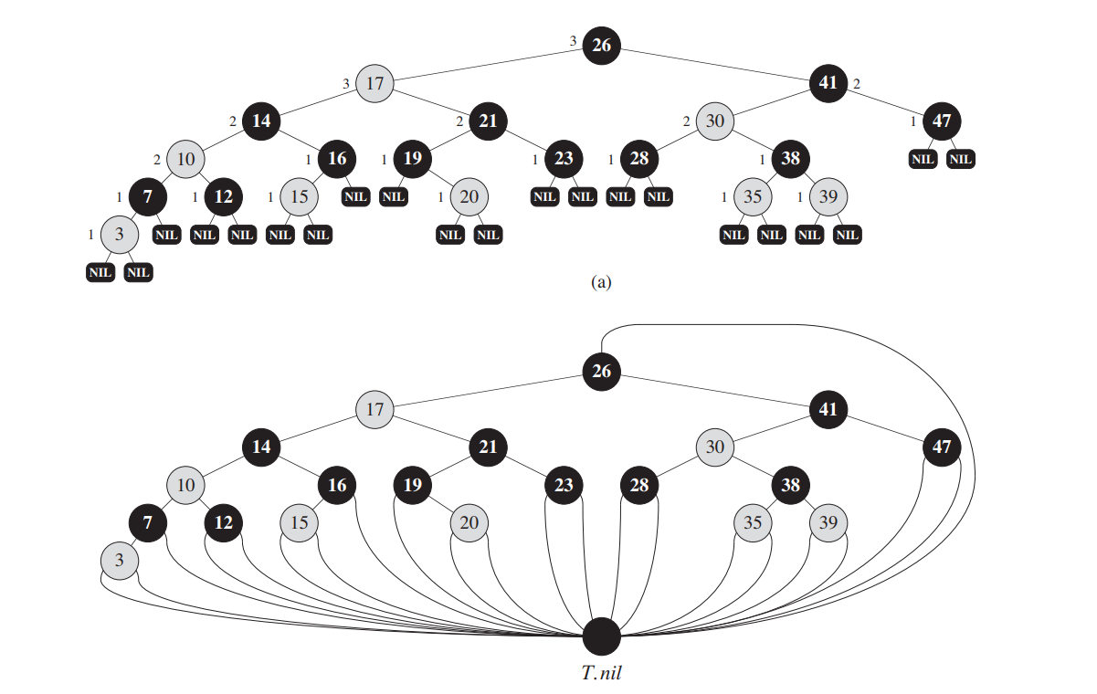
It is better than normal binary search tree as it guarantees complexity of search, insert and delete to be O(log n) in worst case too.
For simplicity of code, all nil nodes are replaced by a sentinel T.nil

Slide 4
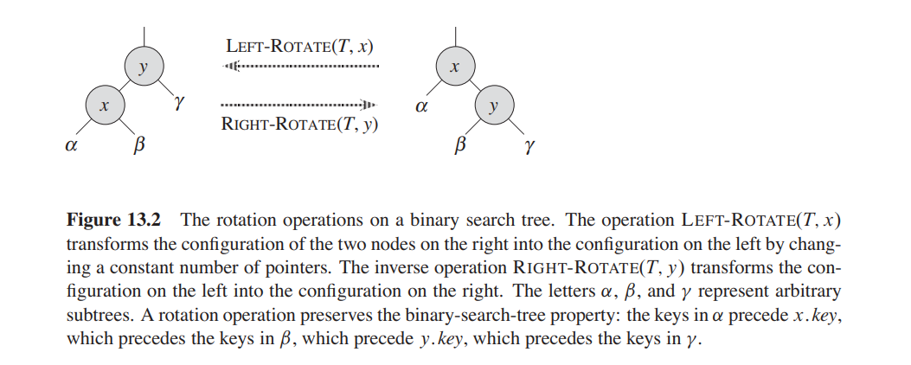
To coordinate the operations of insertion and deletion, we define two other operations as left-rotate and right-rotate as follows:

Slide 5
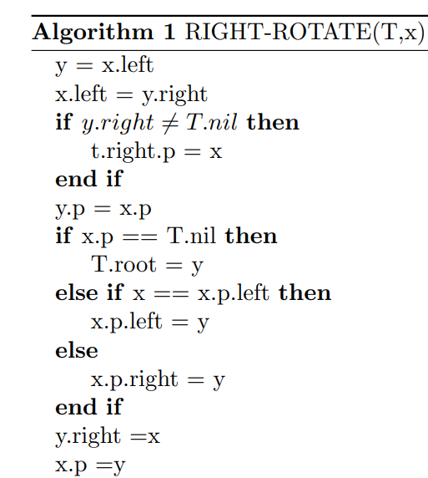
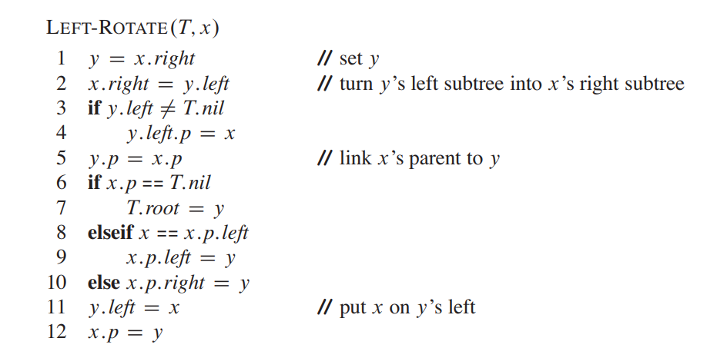
The pseudo codes for left-rotate and right-rotate is given below:

Slide 6
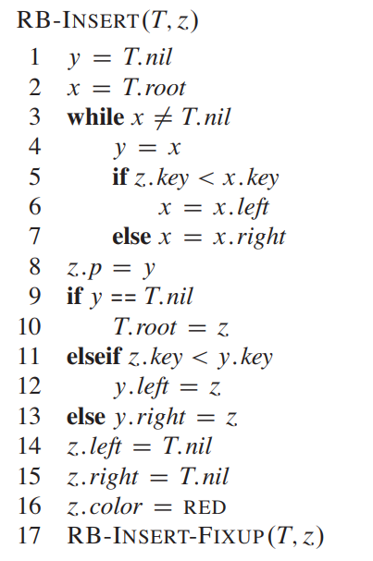
INSERTION
To insert a node into red black tree, we first insert the node at its correct position(which is same as binary search tree i.e. starting from root and going down either left or right depending on value of keys).
We colour the new inserted node as red(line no 16).
But this may cause violation of some of the properties of red-black trees. And to fix it, we call RB-INSERT-FIXUP (Line no 17)

Slide 7
Which properties may be violated?
As we colour new node as red, and if the node to be inserted is the first node(root) then property 2(Refer to slide no 1) will be violated.
If the parent of newly inserted node is red then property 4 will be violated.
The main idea behind insertion is that at most one of the properties 4 and 2 will be violated.
This is because if property 4 violates, then there will be red-red conflict but as we haven’t touched the root the root will be black.
If property 4 doesn’t violate then maybe while bubbling up the newly inserted node(z), and if z becomes the root then it will be red which violates property 4.

Slide 8
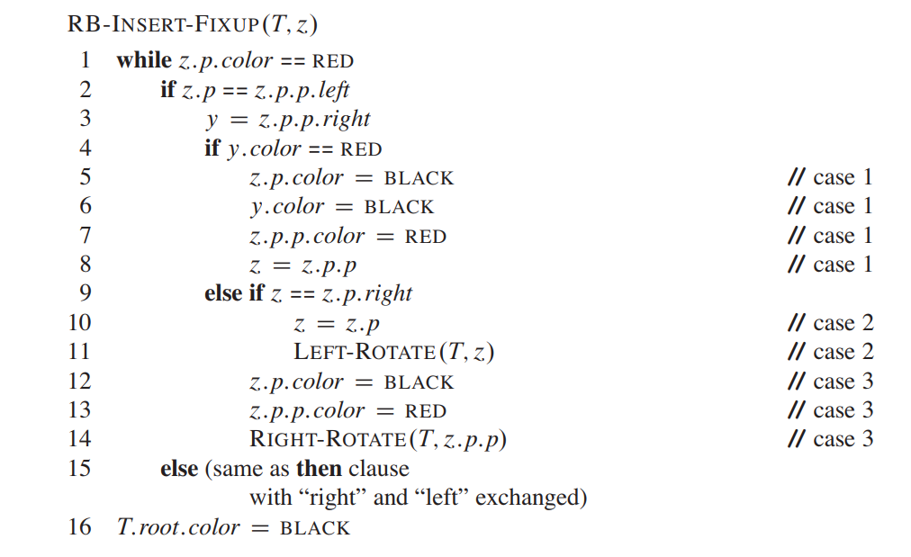

Slide 9
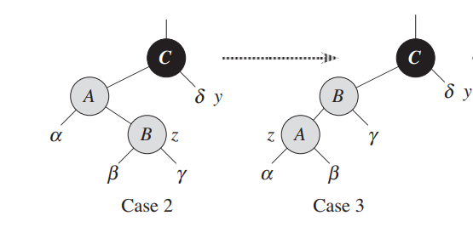
Explanation of RB-INSERT-FIXUP
We divide the analysis into 3 cases:
Z’s uncle, y is red
Z’s uncle, y is black and z is a right child.
Z’s uncle, y is black and z is a left child.
Note that we can convert case 2 into 3 by just performing left-rotation around z.

Slide 10
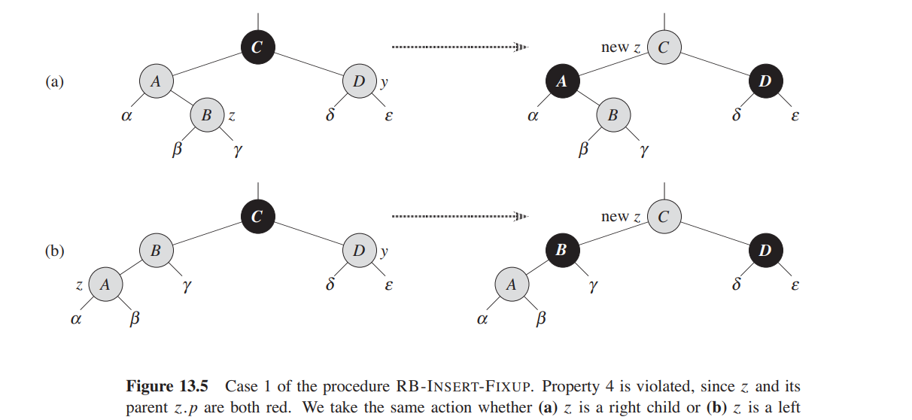
Case 1: z’s uncle y is red
In this case, parent of y should be black(as the remaining tree except z and its parent doesn’t violate property 4)
So, we just bubble up z colouring z.parent and y as black and y.parent as red. Here property 5 isn’t violated as we are colouring both y and z.parent as black so black-height of y.parent remains same.
But now z is pointed to z’s grandparent which may be root and as we colour z as red, property 2 is violated. Hence to take care of this, line 16 colours root as black.

Slide 11
Case 2 and 3: z’s uncle is black.
If case 2 arrives, we do a left rotation immediately (lines 10,11) to convert it into case 3.

